Slide 1
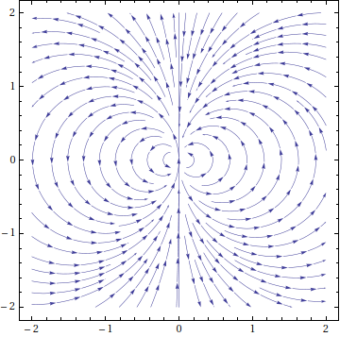
Goal-Based Vector Field Pathfinding
Also known as Flow Field Pathfinding
Originated in fluid dynamics simulations
A collection of arrows with a given magnitude and direction, each attached to a point in the plane
We can make use of this within a tile based Game environment.
Three steps in creating a flow field pathfinder
Create a cost field
Generate the integration field
Generate a flow field

Slide 2
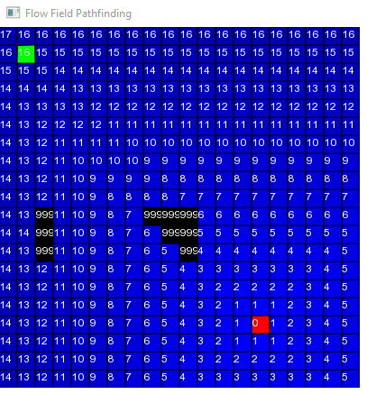
Goal-Based Vector Field Pathfinding
1. Create a cost field (sometimes called a heatmap)
Store the path distance (not Euclidian) from the goal to every tile on the map
First, the algorithm begins at the goal, and marks it with a path distance of 0.
Then, it gets each tile's unmarked neighbours, and marks them with the previous tile's path distance + 1.
This continues until the entire reachable map has been marked.
It is useful to have some way to identify obstacles in the game.
Notes:
This is also know as a Brushfire algorithm or Wavefront algorithm

Slide 3
Goal-Based Vector Field Pathfinding
2. Generate the integration field
First, begin at the goal, and set it’s integration field to 0.
Then, for each tile's unprocessed neighbours, their integration field is calculated by adding the direct distance to the goal tile to it’s cost field.
This continues until the entire reachable map has been marked.
Caveat:
  In theory the neighbour tile with the lowest integration field is the one we would follow on a path to the goal.
  Is this always the case?

Slide 4
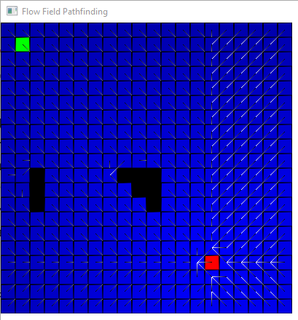
Goal-Based Vector Field Pathfinding
3. Create the flow field (sometimes called a vector field)
The vector field simply stores a vector that points down the gradient of the distance function (towards the goal) at every tile
Vectors point along the shortest path to the goal (in red)
This vector field is generated one tile at a time by looking at the integration fields of its neighbouring cells and identifying the lowest value.

Slide 5
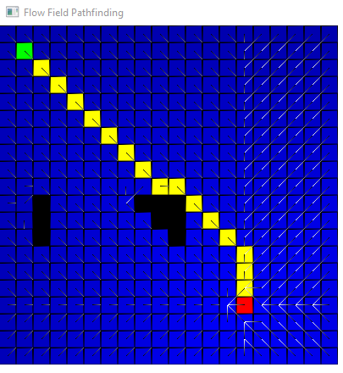
Goal-Based Vector Field Pathfinding
Pathfinder Movement
The NPC simply needs to start moving in the direction indicated by the vector calculated above.
Watch out for local optima
Example1
Example2

